Slide 1

Fliphouse, LLC. Market penetration analysis
Zeth Abney

Slide 2

Business Issues
Penetrating a new market!
Opportunity cost? Potential ROI?
Buy or sell?
When? Where? What?

Slide 3
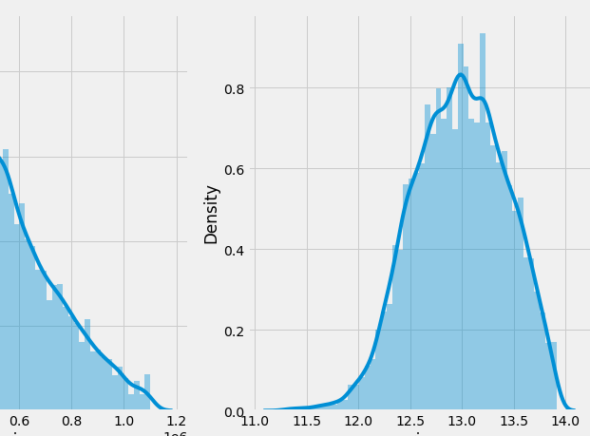
The Dataset
Public data provided by King County, Washington
20k out of 21.5k records used
5% of original data eliminated as “outliers”
8 out of 20 columns used, plus 6 “inferred” column
Time-span of about 1 year

Slide 4
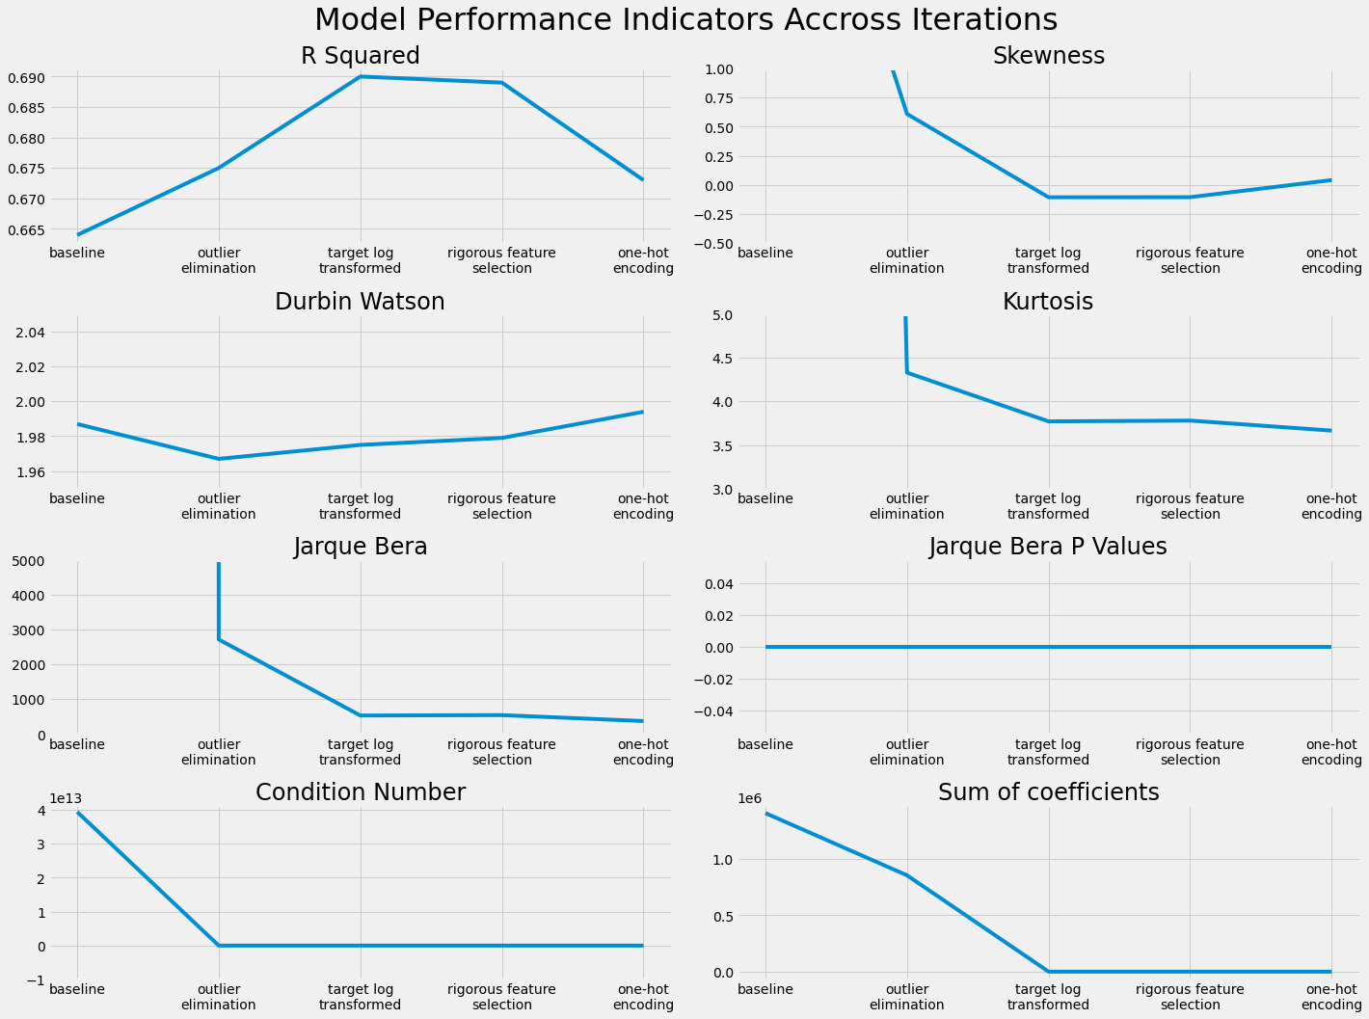
Model Development
Data manipulation (outlier elimination, transformations, encoding, etc.)
Rigorous feature selection and elimination
Model diagnostics (normality, R-squared, etc.)
Model validation (train-test sampling)

Slide 5
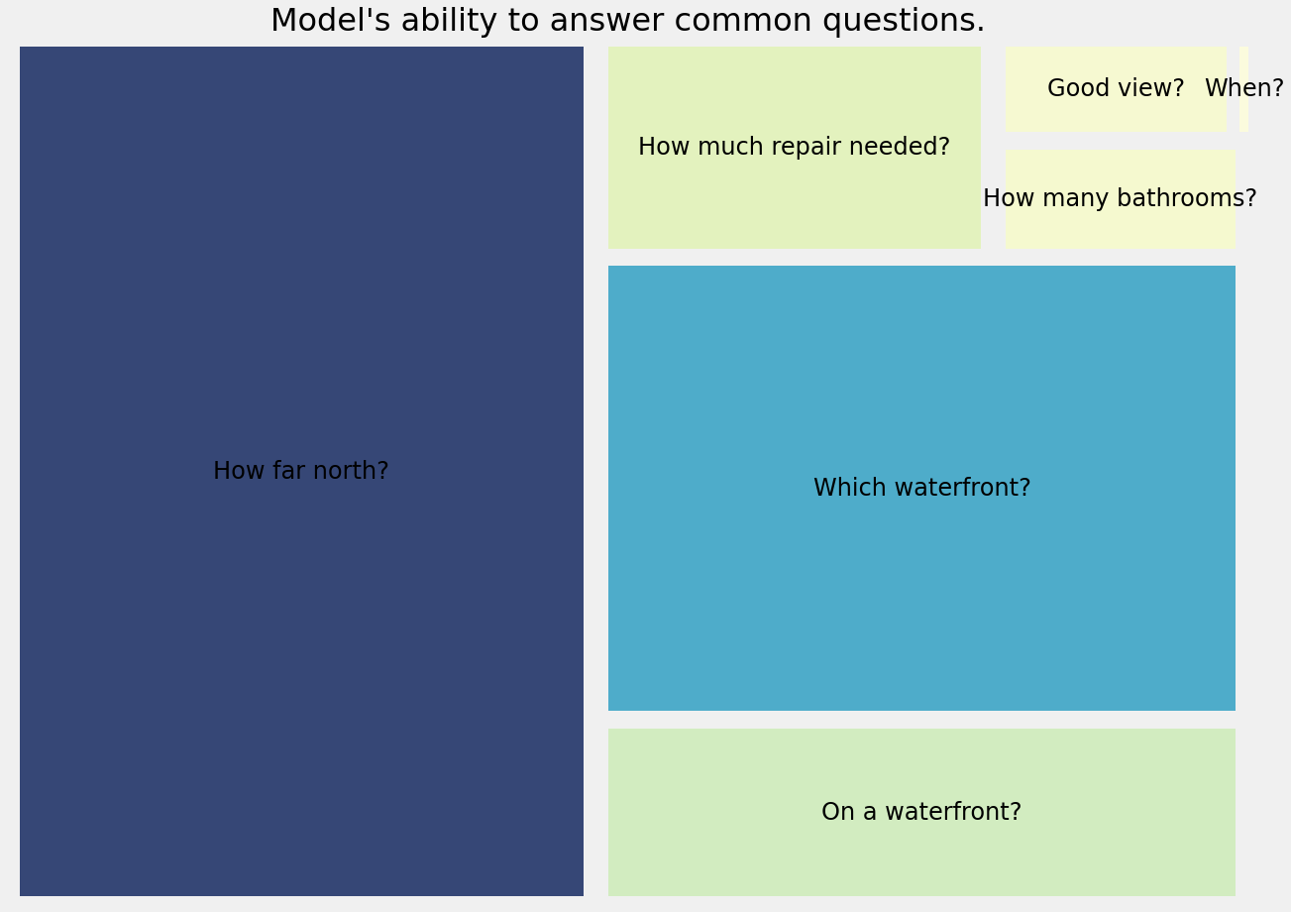
Regression Modeling Results
… Where?
… What?
… When?

Slide 6

Conclusion
North of downtown
On a waterfront (Lake Union!)
Nice view
In need of repair
Add some bathrooms

Slide 7

For More Info
Visit the GitHub repository
Contact Zeth Abney
at zethusabney@gmail.com

